Slide 1
UNIT – II
Relational Model and Relational Algebra

Slide 2
Relational Model Concepts
Relational Model Constraints and Relational Database Schemas
Update Operations
Dealing with constraint violations
Unary Relational Operations:
  SELECT and PROJECT
Relational Algebra Operations from Set Theory
Binary Relational Operations:
  JOIN and DIVISION
Additional Relational Operations
Examples of Queries in Relational Algebra
Relational Database Design Using ER- to-Relational Mapping

Slide 3
Relational Model Concepts
Domains
Attributes
Tuples
Relations

Slide 4
Domain
  A domain D is a set of atomic values. By atomic we mean that each value in the domain is indivisible as far as the relational model is concerned
  A common method of specifying a domain is to specify a data type from which the data values forming the domain are drawn.
E.g: phone_numbers, Names, etc..
  Domain_name datatype;
  USN varchar(10);
  Mobile number(10);
  Salary decimal;

Slide 5
Real time examples
Usa_phone_numbers. The set of ten-digit phone numbers valid in the United States.
Social_security_numbers. The set of valid nine-digit Social Security numbers. (This is a unique identifier assigned to each person in the United States for employment, tax, and benefits purposes.)
Names: The set of character strings that represent names of persons.
Employee_ages. Possible ages of employees in a company; each must be an integer value between 15 and 80.
Academic_department_names. The set of academic department names in a university, such as Computer Science, Economics, and Physics.

Slide 6
Attributes
  Each column in the table is called as attribute.
  Each attribute has specific values.
  Each attribute is represented by A.
ATTRIBUTE
Name | USN | AGE

Slide 7
Tuples
  Each row values for a table is called as tuple.
Name | USN | AGE
Amit | 2GI15CS001 | 20
Dilip | 2GI15CS005 | 23
Samit | 2GI15CS100 | 25
Tuple
Tuple

Slide 8
RELATION: A table of values
  A relation may be thought of as a set of rows.
  A relation may alternately be though of as a set of columns.
  Each row represents a fact that corresponds to a real-world entity or relationship.
  Each row has a value of an item or set of items that uniquely identifies that row in the table.
  Sometimes row-ids or sequential numbers are assigned to identify the rows in the table.
  Each column typically is called by its column name or column header or attribute name.

Slide 9
A Relation may be defined in multiple ways.
The Schema of a Relation: R (A1, A2, .....An)
Relation schema R is defined over attributes A1, A2, .....An
For Example -
CUSTOMER (Cust-id, Cust-name, Address, Phone#)
Here, CUSTOMER is a relation defined over the four attributes Cust-id, Cust-name, Address, Phone#, each of which has a domain or a set of valid values. For example, the domain of Cust-id is 6 digit numbers.

Slide 10
A tuple is an ordered set of values
Each value is derived from an appropriate domain.
Each row in the CUSTOMER table may be referred to as a tuple in the table and would consist of four values.
<632895, "John Smith", "101 Main St. Atlanta, GA 30332", "(404) 894-2000">
is a tuple belonging to the CUSTOMER relation.
A relation may be regarded as a set of tuples (rows).
Columns in a table are also called attributes of the relation.

Slide 11
DEFINITION SUMMARY
Informal Terms |  | Formal Terms
Table |  | Relation
Column |  | Attribute/Domain
Row |  | Tuple
Values in a column |  | Domain
Table Definition |  | Schema of a Relation
Populated Table |  | Extension

Slide 12
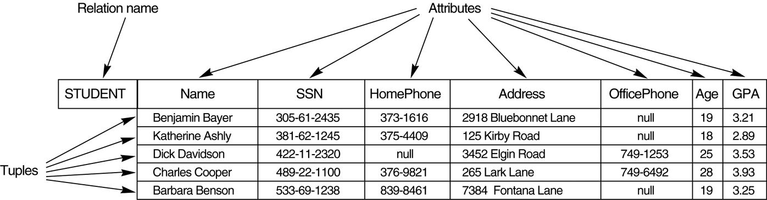

Slide 13
CHARACTERISTICS OF RELATIONS
Ordering of tuples in a relation r(R): The tuples are not considered to be ordered, even though they appear to be in the tabular form.
Ordering of attributes in a relation schema R (and of values within each tuple): We will consider the attributes in R(A₁, A₂, ..., A_{n}) and the values in t=<v₁, v₂, ..., v_{n}> to be ordered .
(However, a more general alternative definition of relation does not require this ordering).
Values in a tuple: All values are considered atomic (indivisible). A special null value is used to represent values that are unknown or inapplicable to certain tuples.

Slide 14
CHARACTERISTICS OF RELATIONS
Ordering of tuples in a relation r(R): The tuples are not considered to be ordered, even though they appear to be in the tabular form.
Rollno | Name | Semester | City
1 | AMIT | II | BELAGAVI
5 | ROHAN | II | PUNE
8 | SUMIT | II | GOKAK
3 | CHETAN | II | B’LORE
2 | ZOYA | II | DHARWAD
4 | GIRISH | II | BELAGAVI
6 | POOJA | II | MUMBAI
7 | SAHIL | II | NAGPUR

Slide 15
CHARACTERISTICS OF RELATIONS
Ordering of attributes in a relation schema R (and of values within each tuple): We will consider the attributes in R(A₁, A₂, ..., A_{n}) and the values in t=<v₁, v₂, ..., v_{n}> to be ordered .
Rollno | Name | Semester | City
1 | AMIT | II | BELAGAVI
5 | ROHAN | II | PUNE
8 | SUMIT | II | GOKAK
3 | CHETAN | II | B’LORE
2 | ZOYA | II | DHARWAD
4 | GIRISH | II | BELAGAVI
6 | POOJA | II | MUMBAI
7 | SAHIL | II | NAGPUR

Slide 16
CHARACTERISTICS OF RELATIONS
Values in a tuple: All values are considered atomic (indivisible). A special null value is used to represent values that are unknown or inapplicable to certain tuples.
Rollno | Name | Semester | City
1 | AMIT | II, SECOND | BELAGAVI
5 | ROHAN | II | PUNE, BELAGAVI
8 | SUMIT | II | GOKAK
3 | CHETAN | II | B’LORE
2 | ZOYA | II | NULL
4 | GIRISH, GIRI | II | BELAGAVI
6 | POOJA, POO | II | MUMBAI
7 | SAHIL | II | NAGPUR

Slide 17
CHARACTERISTICS OF RELATIONS
Values in a tuple: All values are considered atomic (indivisible). A special null value is used to represent values that are unknown or inapplicable to certain tuples.
Rollno | Name | Semester | City
1 | AMIT | II, SECOND | BELAGAVI
5 | ROHAN | II | PUNE, BELAGAVI
8 | SUMIT | II | GOKAK
3 | CHETAN | II | B’LORE
2 | ZOYA | II | DHARWAD
4 | GIRISH, GIRI | II | BELAGAVI
6 | POOJA, POO | II | MUMBAI
7 | SAHIL | II | NAGPUR

Slide 18
Relational Constraints
Constraints are conditions that must hold on all valid relation instances. There are three main types of constraints:
  Key constraints
  Entity integrity constraints
  Referential integrity constraints
  Domain constraints

Slide 19
Key Constraints
Superkey of R: A set of attributes SK of R such that no two tuples in any valid relation instance r(R) will have the same value for SK. That is, for any distinct tuples t1 and t2 in r(R), t1[SK] ≠ t2[SK].
Key of R: A "minimal" superkey; that is, a superkey K such that removal of any attribute from K results in a set of attributes that is not a superkey.
  Example: The CAR relation schema:
  CAR(State, Reg#, SerialNo, Make, Model, Year)
  has two keys Key1 = {State, Reg#}, Key2 = {SerialNo}, which are also superkeys. {SerialNo, Make} is a superkey but not a key.
If a relation has several candidate keys, one is chosen arbitrarily to be the primary key. The primary key attributes are underlined.

Slide 20
EXAMPLE
Key is = rollno
Since t1(sk) = t2(sk)
Rollno | Name | Semester | City
1 | AMIT | II | BELAGAVI
5 | ROHAN | II | PUNE,
1 | SUMIT | II | GOKAK
3 | CHETAN | II | B’LORE
8 | ZOYA | II | DHARWAD
4 | GIRISH | II | BELAGAVI
6 | POOJA | II | MUMBAI
7 | AMIT | II | NAGPUR

Slide 21
Entity Integrity
Relational Database Schema: A set S of relation schemas that belong to the same database. S is the name of the database.
S = {R₁, R₂, ..., R_{n}}
Entity Integrity: The primary key attributes PK of each relation schema R in S cannot have null values in any tuple of r(R). This is because primary key values are used to identify the individual tuples.
t[PK] ≠ null for any tuple t in r(R)
Note: Other attributes of R may be similarly constrained to disallow null values, even though they are not members of the primary key.

Slide 22
EXAMPLE
Key is = rollno
Since t3(pk) = NULL
Rollno | Name | Semester | City
1 | AMIT | II | BELAGAVI
5 | ROHAN | II | PUNE,
NULL | SUMIT | II | GOKAK
3 | CHETAN | II | B’LORE
2 | ZOYA | II | DHARWAD
4 | GIRISH | II | BELAGAVI
6 | POOJA | II | NULL
7 | SAHIL | II | NAGPUR

Slide 23
Referential Integrity
A constraint involving two relations (the previous constraints involve a single relation).
Used to specify a relationship among tuples in two relations: the referencing relation and the referenced relation.
Tuples in the referencing relation R₁ have attributes FK (called foreign key attributes) that reference the primary key attributes PK of the referenced relation R₂. A tuple t₁ in R₁ is said to reference a tuple t₂ in R₂ if t₁[FK] = t₂[PK].
A referential integrity constraint can be displayed in a relational database schema as a directed arc from R₁.FK to R₂.

Slide 24
Example
Assume department table in GIT
Assume student table listed below
DeptName | Location
CSE | FIRST FLOOR
EC | FIRST FLOOR
IS | SECOND FLOOR
USN | Name | Lname | Dept
1 | Amit | Patil | CSE
2 | Dilip | Naik | EC
3 | Anand | Kulkarni | MECH
4 | Ganesh | Hegde | IS

Slide 25
Assume department table in GIT
Assume student table listed below
DeptName | Location
CSE | FIRST FLOOR
EC | FIRST FLOOR
IS | SECOND FLOOR
USN | Name | Lname | Dept
1 | Amit | Patil | CS
2 | Dilip | Naik | EC
3 | Anand | Kulkarni | MECH
4 | Ganesh | Hegde | IS

Slide 26
Referential Integrity Constraint
Statement of the constraint
The value in the foreign key column (or columns) FK of the the referencing relation R₁ can be either:
(1) a value of an existing primary key value of the corresponding primary key PK in the referenced relation R_{2,}, or..
(2) a null.
In case (2), the FK in R₁ should not be a part of its own primary key.

Slide 27
Domain Integrity Constraint
Statement of the constraint
The value for any attribute should not be null.
Rollno | Name | Semester | City
1 | AMIT | II, SECOND | BELAGAVI
5 | ROHAN | II | PUNE, BELAGAVI
8 | SUMIT | II | GOKAK
3 | CHETAN | II | B’LORE
2 | ZOYA | II | NULL
4 | GIRISH, GIRI | II | BELAGAVI
6 | POOJA, POO | II | MUMBAI
7 | SAHIL | II | NAGPUR

Slide 28
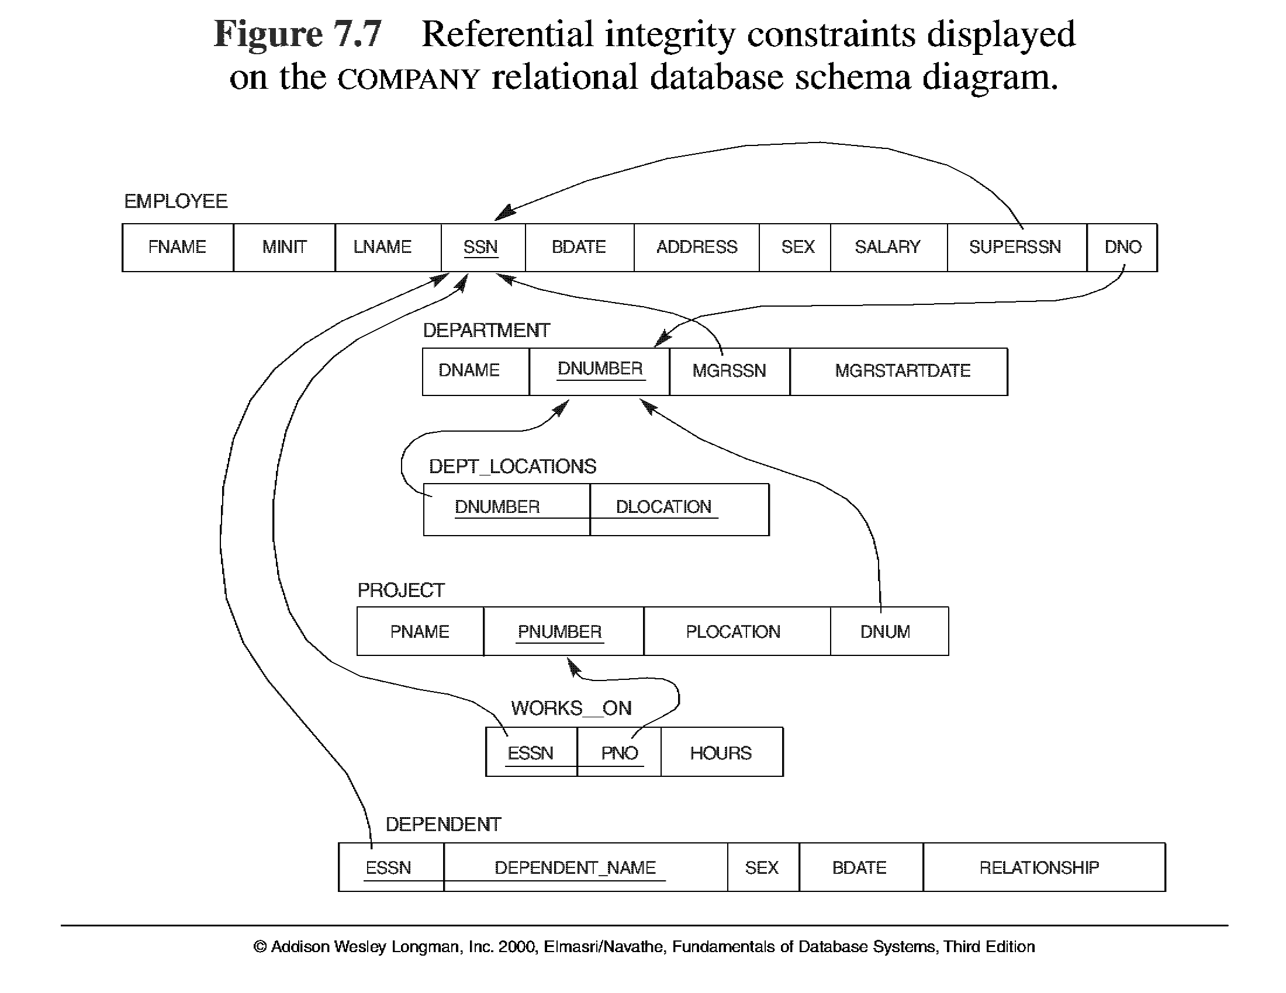

Slide 29
SCHEMA DIAGRAM(EXAMPLE)
Flights
FNO
FP
TP
DISTANCE
ARRIVES
PRICE
Aircrafts
AID
ANAME
RANGE
Certified
EID
AID
Employees
EID
ENAME
SALARY

Slide 30
SCHEMA DIAGRAM(EXAMPLE)
Flights
FNO
FP
TP
DISTANCE
ARRIVES
PRICE
Aircrafts
AID
ANAME
RANGE
Certified
EID
AID
Employees
EID
ENAME
SALARY

Slide 31
SCHEMA DIAGRAM
Flights
FNO
FP
TP
DISTANCE
ARRIVES
PRICE
Aircrafts
AID
ANAME
RANGE
Certified
EID
AID
Employees
EID
ENAME
SALARY

Slide 32
Insurance Company Database (Example)
PERSON | driver_id:string | name:string | address:string
CAR | regno:string | model:string | year:int
ACCIDENT | rep_no:int | accd_date:date | location:string
OWNS | driver_id:string | regno:string
PARTICIPATED | driver_id:string | regno:string | repno:int | damount:int

Slide 33
PERSON | driver_id:string | name:string | address:string
CAR | regno:string | model:string | year:int
ACCIDENT | rep_no:int | accd_date:date | location:string
OWNS | driver_id:string | regno:string
PARTICIPATED | driver_id:string | regno:string | repno:int | damount:int

Slide 34
PERSON | driver_id:string | name:string | address:string
CAR | regno:string | model:string | year:int
ACCIDENT | rep_no:int | accd_date:date | location:string
OWNS | driver_id:string | regno:string
PARTICIPATED | driver_id:string | regno:string | repno:int | damount:int

Slide 35
Update Operations and Dealing with Constraint Violations
The Insert Operation
  Insert is used to insert a new tuple or tuples in a relation
The Delete Operation
  Delete is used to delete tuples
The Update Operation
  Update (or Modify) is used to change the values of some attributes in existing tuples

Slide 36
Employee table
INSERT EXAMPLE
FNAME | MNAME | LNAME | SSN | DOB | ADDR | GENDER | SALARY | MOB | DEPTNo
SAM | J | ROY | 999887777 | 1960-01-01 | Texas | M | 25000 | 990019900 | 1
Department table
DNO | DNAME | DLOC
1 | TESTING | NY
2 | PRODUCTION | TEXAS
3 | MANUFACTURING | TEXAS

Slide 37
Here are some examples to illustrate this discussion
1. Insert <‘Cecilia’, ‘F’, ‘Kolonsky’, null, ‘1960-04-05’, ‘6357 Windy Lane, Katy, TX’, F, 28000, null, 3> into EMPLOYEE.
o This insertion violates the entity integrity constraint (null for the primary key SSN), so it is rejected.
2. Insert <‘Alicia’, ‘J’, ‘Zelaya’, ‘999887777’, ‘1960-04-05’, ‘6357 Windy Lane, Katy, TX’, F, 28000, ‘987654321’, 3> into EMPLOYEE.
o This insertion violates the key constraint because another tuple with the same SSN value already exists in the EMPLOYEE relation, and so it is rejected.
3. Insert <‘Cecilia’, ‘F’, ‘Kolonsky’, ‘677678989’, ‘1960-04-05’, ‘6357 Windswept, Katy, TX’, F, 28000, ‘987654321’, 7> into EMPLOYEE.
o This insertion violates the referential integrity constraint specified on DNO because no DEPARTMENT tuple exists with DNUMBER = 7.
4. Insert <‘Cecilia’, ‘F’, ‘Kolonsky’, ‘677678989’, ‘1960-04-05’, ‘6357 Windy Lane, Katy, TX’, F, 28000, null, 3> into EMPLOYEE.
o This insertion satisfies all constraints, so it is acceptable.

Slide 38
Employee table
DELETE EXAMPLE
FNAME | MNAME | LNAME | SSN | DOB | ADDR | GENDER | SALARY | MOB | DEPTNo
SAM | J | ROY | 999887777 | 1960-01-01 | Texas | M | 25000 | 990019900 | 1
TIM | K | BOLT | 111223333 | 1961-02-02 | NY | M | 30000 | 987519854 | 2
Department table
DNO | DNMAE | DLOC
1 | TESTING | NY
2 | PRODUCTION | TEXAS
3 | MANUFACTURING | TEXAS

Slide 39
The Delete Operation
1. Delete the EMPLOYEE tuple with ESSN = ‘999887777’ .
o This deletion is acceptable.
2. Delete the DEPARTMENT tuple with DNO = ‘1’.
o This deletion is not acceptable, because tuples in EMPLOYEE refer to this tuple. Hence, if the tuple is deleted, referential integrity violations will result.

Slide 40
Employee table
UPDATE EXAMPLE
FNAME | MNAME | LNAME | SSN | DOB | ADDR | GENDER | SALARY | MOB | DEPTNo
SAM | J | ROY | 999887777 | 1960-01-01 | Texas | M | 25000 | 990019900 | 1
TIM | K | BOLT | 111223333 | 1961-02-02 | NY | M | 30000 | 987519854 | 2
Department table
DNO | DNAME | DLOC
1 | TESTING | NY
2 | PRODUCTION | TEXAS
3 | MANUFACTURING | TEXAS

Slide 41
The Update Operation
1. Update the SALARY of the EMPLOYEE tuple with SSN = ‘999887777’ to 28000.
o Acceptable.
2. Update the DNO of the EMPLOYEE tuple with SSN = ‘999887777’ to 1.
o Acceptable.
3. Update the DNO of the EMPLOYEE tuple with SSN = ‘999887777’ to 7.
o Unacceptable, because it violates referential integrity.
4. Update the SSN of the EMPLOYEE tuple with SSN = ‘999887777’ to ‘111223333’.
o Unacceptable, because it violates primary key and referential integrity constraints.

Slide 42
In-short
Insert violates
  Primary Key constraints
  Entity integrity constraint
  Referential integrity constraint
Delete violates
  Referential integrity constraint
Update violates
  Primary Key constraints
  Referential integrity constraint

Slide 43
What is Relational Algebra?
It is a language in which we can ask questions (query) of a database.
Basic premise is that tables are sets (mathematical) and so our query language should manipulate sets with ease.
Traditional Set Operations:
  union, intersection, Cartesian product, set difference
Extended Set Operations:
  selection, projection, join, quotient
Database Principles

Slide 44
Unary Relational Operations: SELECT
The SELECT operation (denoted by σ (sigma)) is used to select a subset of the tuples from a relation based on a selection condition.
  The selection condition acts as a filter
  Keeps only those tuples that satisfy the qualifying condition
  Tuples satisfying the condition are selected whereas the other tuples are discarded (filtered out)
Examples:
  Select the EMPLOYEE tuples whose department number is 4:
σ _{DNO = 4} (EMPLOYEE)
  Select the employee tuples whose salary is greater than $30,000:
σ _{SALARY > 30,000} (EMPLOYEE)
Slide 6- <number>

Slide 45
Unary Relational Operations: SELECT
  In general, the select operation is denoted by
  σ _{<selection condition>}(R) where
    the symbol σ (sigma) is used to denote the select operator
    the selection condition is a Boolean (conditional) expression specified on the attributes of relation R
    tuples that make the condition true are selected
      appear in the result of the operation
    tuples that make the condition false are filtered out
      discarded from the result of the operation
Slide 6- <number>

Slide 46
Unary Relational Operations: PROJECT
PROJECT Operation is denoted by π (pi)
This operation keeps certain columns (attributes) from a relation and discards the other columns.
  PROJECT creates a vertical partitioning
    The list of specified columns (attributes) is kept in each tuple
    The other attributes in each tuple are discarded
Example: To list each employee’s first and last name and salary, the following is used:
  π_{LNAME, FNAME,SALARY}(EMPLOYEE)
Slide 6- <number>

Slide 47
Unary Relational Operations: PROJECT (cont.)
The general form of the project operation is:
π_{<attribute list>}(R)
  π (pi) is the symbol used to represent the project operation
  <attribute list> is the desired list of attributes from relation R.
The project operation removes any duplicate tuples
  This is because the result of the project operation must be a set of tuples
    Mathematical sets do not allow duplicate elements.
Slide 6- <number>

Slide 48
STUDENT TABLE
USN | NAME | AGE | SEM | BRANCH
2GI15CS001 | AMIT | 21 | 4 | CS
2GI15CS004 | DILIP | 22 | 4 | CS
2GI14EE001 | SAMIT | 21 | 6 | EE
2GI14ME035 | SUPRIT | 23 | 6 | ME
Database Principles

Slide 49
STUDENT TABLE
USN | NAME | AGE | SEM | BRANCH
2GI15CS001 | AMIT | 21 | 4 | CS
2GI15CS004 | DILIP | 22 | 4 | CS
2GI14EE001 | SAMIT | 21 | 6 | EE
2GI14ME035 | SUPRIT | 23 | 6 | ME
1.Find student name, age who belong to CS department.
Database Principles

Slide 50
STUDENT TABLE
USN | NAME | AGE | SEM | BRANCH
2GI15CS001 | AMIT | 21 | 4 | CS
2GI15CS004 | DILIP | 22 | 4 | CS
2GI14EE001 | SAMIT | 21 | 6 | EE
2GI14ME035 | SUPRIT | 23 | 6 | ME
1.Find student name, age who belong to CS department.
πname, age(σbranch =‘CS’(STUDENT))
Database Principles

Slide 51
STUDENT TABLE
USN | NAME | AGE | SEM | BRANCH
2GI15CS001 | AMIT | 21 | 4 | CS
2GI15CS004 | DILIP | 22 | 4 | CS
2GI14EE001 | SAMIT | 21 | 6 | EE
2GI14ME035 | SUPRIT | 23 | 6 | ME
2.Find student USN and name whose age is between 18 and 21.
Database Principles

Slide 52
STUDENT TABLE
USN | NAME | AGE | SEM | BRANCH
2GI15CS001 | AMIT | 21 | 4 | CS
2GI15CS004 | DILIP | 22 | 4 | CS
2GI14EE001 | SAMIT | 21 | 6 | EE
2GI14ME035 | SUPRIT | 23 | 6 | ME
2.Find student USN and name whose age is between 18 and 21.
πusn, name(σage>=18 and age<=21 (STUDENT))
Database Principles

Slide 53
STUDENT TABLE
USN | NAME | AGE | SEM | BRANCH
2GI15CS001 | AMIT | 21 | 4 | CS
2GI15CS004 | DILIP | 22 | 4 | CS
2GI14EE001 | SAMIT | 21 | 6 | EE
2GI14ME035 | SUPRIT | 23 | 6 | ME
3.Find student name who is in 4 sem and branch is EE
Database Principles

Slide 54
STUDENT TABLE
USN | NAME | AGE | SEM | BRANCH
2GI15CS001 | AMIT | 21 | 4 | CS
2GI15CS004 | DILIP | 22 | 4 | CS
2GI14EE001 | SAMIT | 21 | 6 | EE
2GI14ME035 | SUPRIT | 23 | 6 | ME
3.Find student name who is in 4 sem and branch is EE
πname(σsem=4 and branch=‘EE’ (STUDENT))
Database Principles

Slide 55
STUDENT TABLE
USN | NAME | AGE | SEM | BRANCH
2GI15CS001 | AMIT | 21 | 4 | CS
2GI15CS004 | DILIP | 22 | 4 | CS
2GI14EE001 | SAMIT | 21 | 6 | EE
2GI14ME035 | SUPRIT | 23 | 6 | ME
4.Find student names whose age is more than 21 or who belongs to CS branch.
Database Principles

Slide 56
STUDENT TABLE
USN | NAME | AGE | SEM | BRANCH
2GI15CS001 | AMIT | 21 | 4 | CS
2GI15CS004 | DILIP | 22 | 4 | CS
2GI14EE001 | SAMIT | 21 | 6 | EE
2GI14ME035 | SUPRIT | 23 | 6 | ME
4.Find student names whose age is more than 21 or who belongs to CS branch.
πname(σage>21 or branch=‘CS’ (STUDENT))
Database Principles

Slide 57
STUDENT TABLE
USN | NAME | AGE | SEM | BRANCH
2GI15CS001 | AMIT | 21 | 4 | CS
2GI15CS004 | DILIP | 22 | 4 | CS
2GI14EE001 | SAMIT | 21 | 6 | EE
2GI14ME035 | SUPRIT | 23 | 6 | ME
Here every new relation can be given a new name…. Since it is combination of relation…
It is called as sequencing of relations.
Database Principles

Slide 58
STUDENT TABLE
USN | NAME | AGE | SEM | BRANCH
2GI15CS001 | AMIT | 21 | 4 | CS
2GI15CS004 | DILIP | 22 | 4 | CS
2GI14EE001 | SAMIT | 21 | 6 | EE
2GI14ME035 | SUPRIT | 23 | 6 | ME
1.Find student name, age who belong to CS department.
Here first find the student details who belong to CS department.
Second from the above result just fetch name and age….
Database Principles

Slide 59
STUDENT TABLE
USN | NAME | AGE | SEM | BRANCH
2GI15CS001 | AMIT | 21 | 4 | CS
2GI15CS004 | DILIP | 22 | 4 | CS
2GI14EE001 | SAMIT | 21 | 6 | EE
2GI14ME035 | SUPRIT | 23 | 6 | ME
1.Find student name, age who belong to CS department.
CS_STUD ←σbranch =‘CS’(STUDENT)
RESULT ← πname, age(CS_STUD)
Database Principles

Slide 60
STUDENT TABLE
USN | NAME | AGE | SEM | BRANCH
2GI15CS001 | AMIT | 21 | 4 | CS
2GI15CS004 | DILIP | 22 | 4 | CS
2GI14EE001 | SAMIT | 21 | 6 | EE
2GI14ME035 | SUPRIT | 23 | 6 | ME
2.Find student USN and name whose age is between 18 and 21.
Database Principles

Slide 61
STUDENT TABLE
USN | NAME | AGE | SEM | BRANCH
2GI15CS001 | AMIT | 21 | 4 | CS
2GI15CS004 | DILIP | 22 | 4 | CS
2GI14EE001 | SAMIT | 21 | 6 | EE
2GI14ME035 | SUPRIT | 23 | 6 | ME
2.Find student USN and name whose age is between 18 and 21.
Database Principles

Slide 62
STUDENT TABLE
USN | NAME | AGE | SEM | BRANCH
2GI15CS001 | AMIT | 21 | 4 | CS
2GI15CS004 | DILIP | 22 | 4 | CS
2GI14EE001 | SAMIT | 21 | 6 | EE
2GI14ME035 | SUPRIT | 23 | 6 | ME
3.Find student name who is in 4 sem and branch is EE
Database Principles

Slide 63
STUDENT TABLE
USN | NAME | AGE | SEM | BRANCH
2GI15CS001 | AMIT | 21 | 4 | CS
2GI15CS004 | DILIP | 22 | 4 | CS
2GI14EE001 | SAMIT | 21 | 6 | EE
2GI14ME035 | SUPRIT | 23 | 6 | ME
3.Find student name who is in 4 sem and branch is EE
Database Principles

Slide 64
STUDENT TABLE
USN | NAME | AGE | SEM | BRANCH
2GI15CS001 | AMIT | 21 | 4 | CS
2GI15CS004 | DILIP | 22 | 4 | CS
2GI14EE001 | SAMIT | 21 | 6 | EE
2GI14ME035 | SUPRIT | 23 | 4 | ME
4.Find student names whose age is more than 21 or who belongs to CS branch.
Database Principles

Slide 65
STUDENT TABLE
USN | NAME | AGE | SEM | BRANCH
2GI15CS001 | AMIT | 21 | 4 | CS
2GI15CS004 | DILIP | 22 | 4 | CS
2GI14EE001 | SAMIT | 21 | 6 | EE
2GI14ME035 | SUPRIT | 23 | 6 | ME
4.Find student names whose age is more than 21 or who belongs to CS branch.
Database Principles

Slide 66
SET THEORY OPERATIONS on RELATIONAL ALGEBRA
Cartesian Product
Union
Intersection
Set Difference
Database Principles

Slide 67
CARTESIAN PRODUCT:
The Cartesian product of two sets is a set of pairs of elements (tuples), one from each set.
If the original sets are already sets of tuples then the tuples in the Cartesian product are all that bigger.
Syntax:
As we have seen, Cartesian products are usually unrelated to a real-world thing. They normally contain some noise tuples.
However they may be useful as a first step.
<table_name> x <table_name>
Database Principles

Slide 68
CARTESIAN PRODUCT:
Roll | Name | Dept
1 | Amit | CS
2 | Dilip | EC
3 | Sumit | CS
Dept | Loc
CS | TF
EC | FF
Roll | Name | Dept | Dept | Loc
1 | Amit | CS | CS | TF
1 | Amit | CS | EC | FF
2 | Dilip | EC | CS | TF
2 | Dilip | EC | EC | FF
3 | Sumit | CS | CS | TF
3 | Sumit | CS | EC | FF

Slide 69
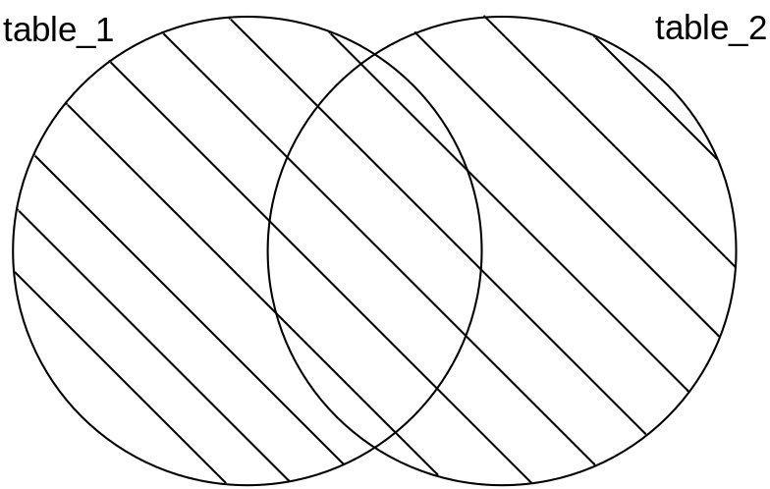
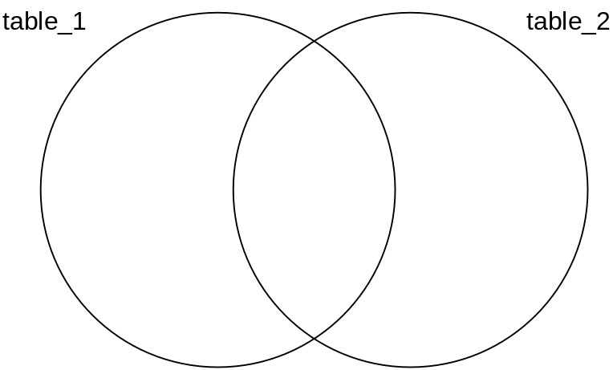
UNION:
Treat two tables as sets and perform a set union
Syntax:
Observations:
  This operation is impossible unless both tables involved have the same schemas. Why?
  Because rows from both tables must fit into a single answer table; hence they must “look alike”.
  Because some rows might already belong to both tables
Table1 UNION Table2
alternatively
Table1 Table2
U
Database Principles
Notes:
Eval info, conceptualize

Slide 70


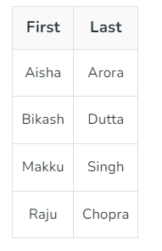
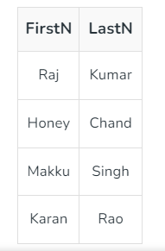

Slide 71

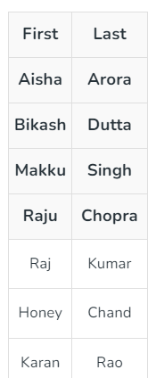

Slide 72
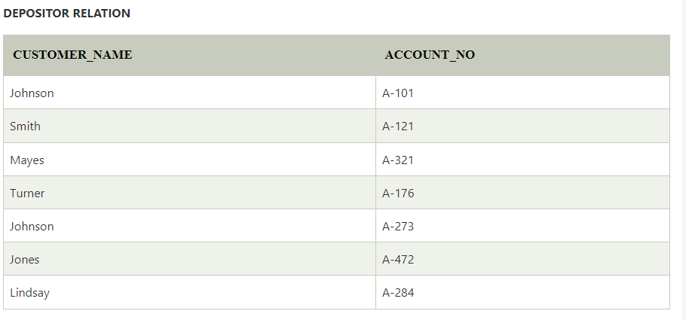
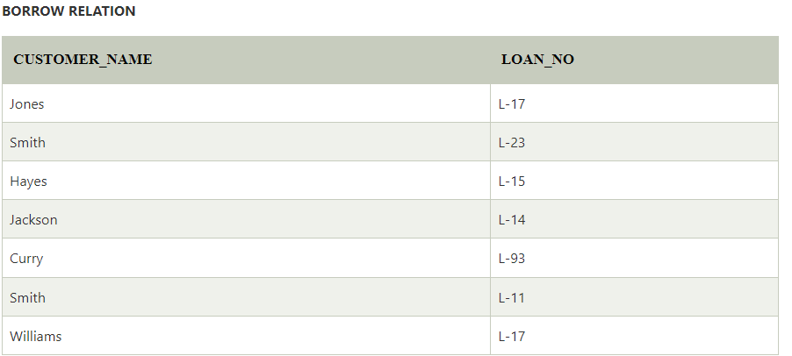

Slide 73

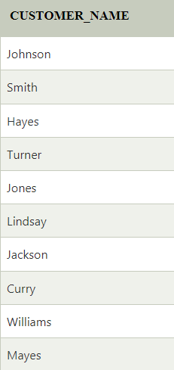

Slide 74
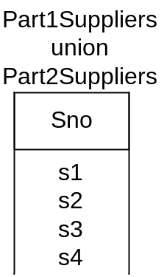
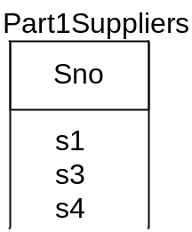
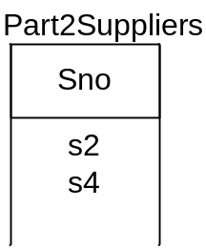
UNION Example:
Part1Suppliers = project (select Supplies where Pno = ‘p1’) over Sno
Part2Suppliers = project (select Supplies where Pno = ‘p2’) over Sno
Part1Suppliers UNION Part2Suppliers
alternatively
Part1Suppliers ← π_{Sno}(σ_{Pno = ‘p1’} (Supplies) )
Part2Suppliers ← π_{Sno}(σ_{Pno = ‘p2’} (Supplies) )
Answer ← Part1Suppliers Part2Suppliers
U

Slide 75
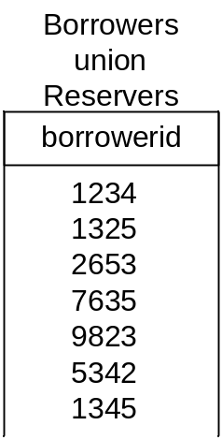
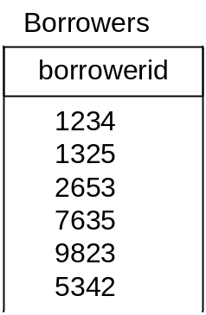
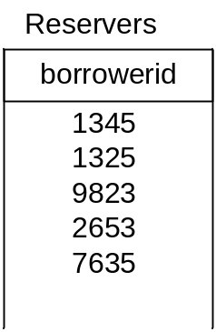
UNION Exercise:
Find the borrower numbers of all borrowers who have either borrowed or reserved a book (any book).
Reservers = project Reserves over borrowerid
Borrowers = project Borrows over borrowerid
Answer = Borrowers union Reservers
alternatively
Reservers ← π_{borrowerid} (Reserves)
Borrowers ← π_{borrowerid}(Borrows)
Answer ← Borrowers Reservers
U
not duplicated

Slide 76
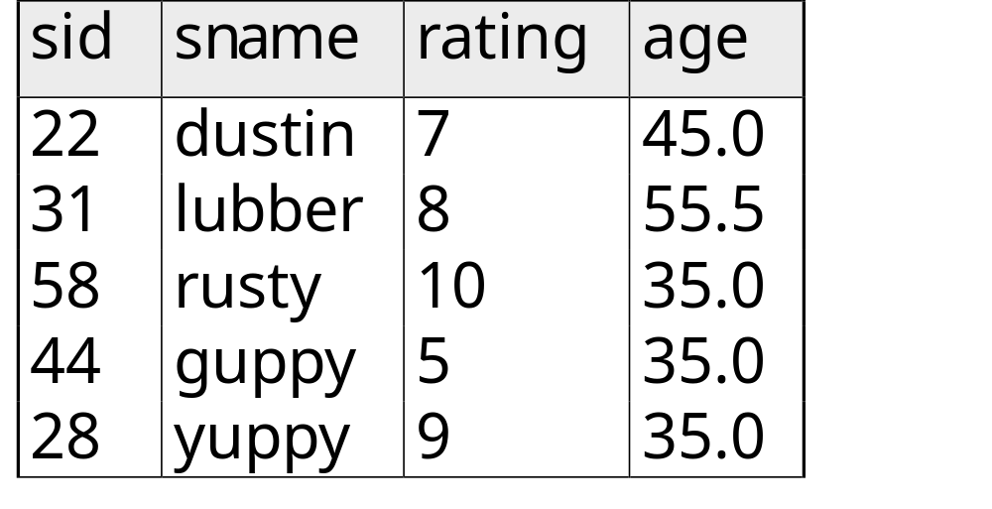
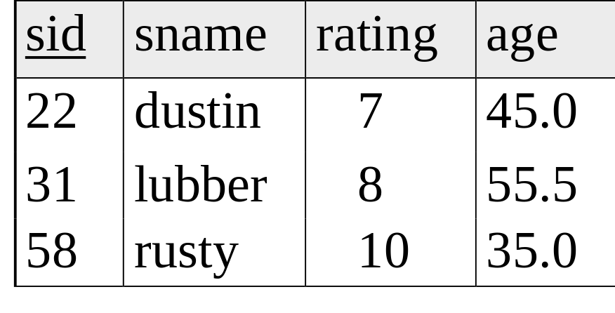
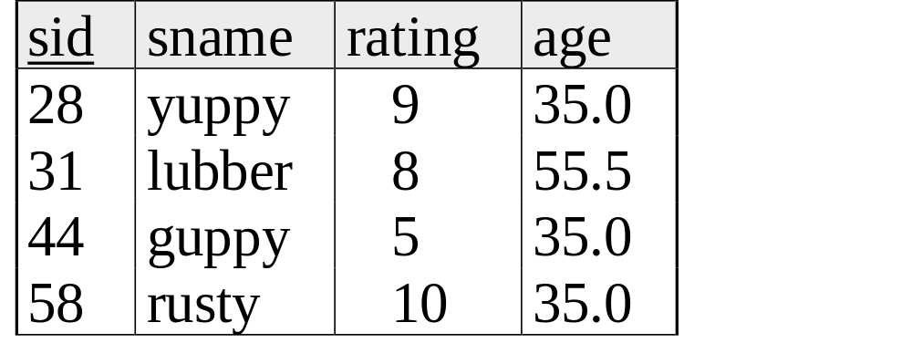

Union
S1
S2

Slide 77
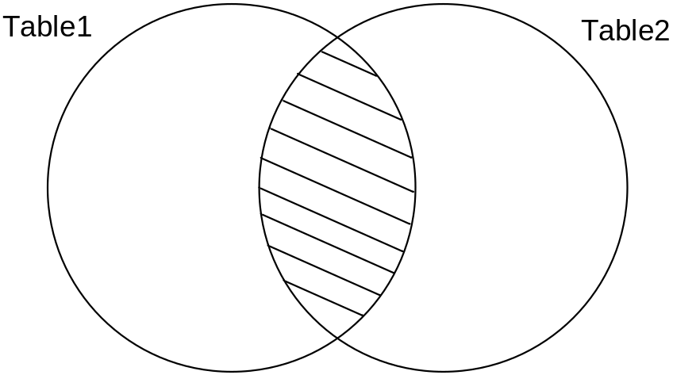
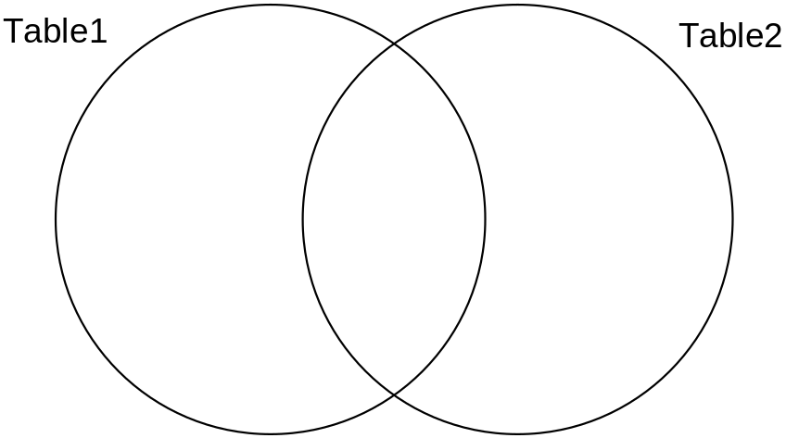
INTERSECTION:
Treat two tables as sets and perform a set intersection
Syntax:
Observations:
  This operation is impossible unless both tables involved have the same schemas. Why?
  Because rows from both tables must fit into a single answer table; hence they must “look alike”.
Table1 INTERSECTION Table2
alternatively
Table1 Table2
∩
Database Principles
Notes:
Eval info, conceptualize

Slide 79


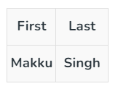

Slide 80
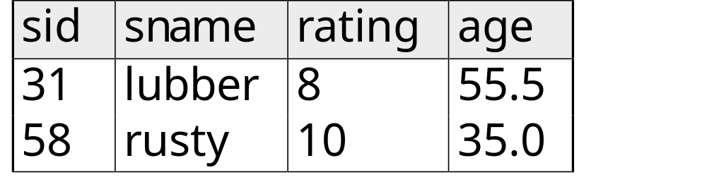

Intersection
S1
S2

Slide 82

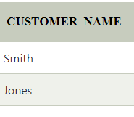

Slide 83
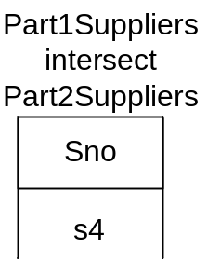
INTERSECTION Example:
Part1Suppliers = project (select Supplies where Pno = ‘p1’) over Sno
Part2Suppliers = project (select Supplies where Pno = ‘p2’) over Sno
Part1Suppliers INTERSECT Part2Suppliers
alternatively
Part1Suppliers ← π_{Sno}(σ_{Pno = ‘p1’} (Supplies) )
Part2Suppliers ← π_{Sno}(σ _{Pno = ‘p2’} (Supplies) )
Answer ← Part1Suppliers Part2Suppliers
∩
Database Principles

Slide 84
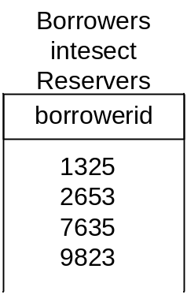
INTERSECTION Exercise:
Find the borrower numbers of all borrowers who have borrowed and reserved a book.
Reservers = project Reserves over borrowerid
Borrowers = project Borrows over borrowerid
Answer = Borrowers intersect Reservers
alternatively
Reservers ← π_{borrowerid} (Reserves)
Borrowers ← π_{borrowerid}(Borrows)
Answer ← Borrowers Reservers
∩
Database Principles

Slide 85
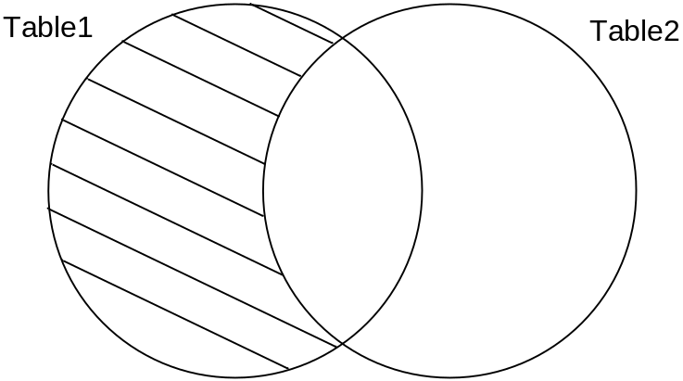
SET DIFFERENCE:
Treat two tables as sets and perform a set intersection
Syntax:
Observations:
  This operation is impossible unless both tables involved have the same schemas. Why?
  Because it only makes sense to calculate the set difference if the two sets have elements in common.
Table1 MINUS Table2
alternatively
Table1 - Table2
Database Principles
Notes:
Eval info, conceptualize

Slide 87


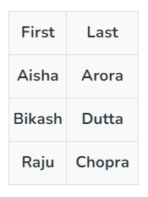

Slide 88

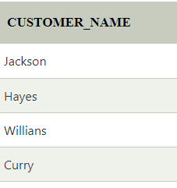

Slide 89
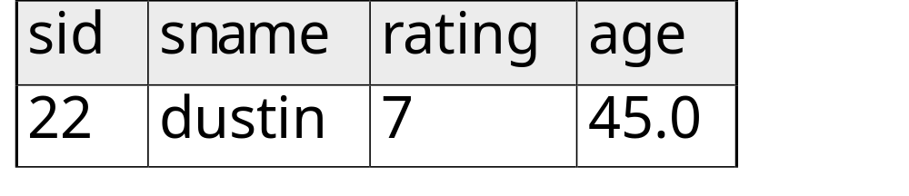

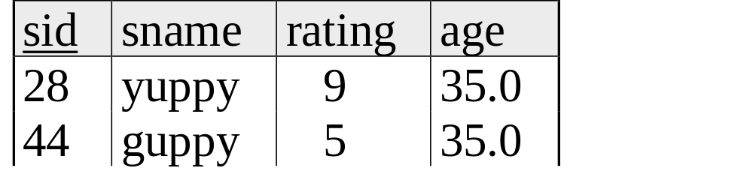
Set Difference
S1
S2 – S1
S2

Slide 90
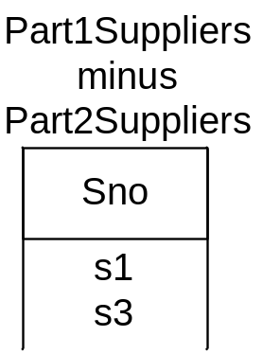
SET DIFFERENCE Example:
Part1Suppliers = project (select Supplies where Pno = ‘p1’) over Sno
Part2Suppliers = project (select Supplies where Pno = ‘p2’) over Sno
Part1Suppliers MINUS Part2Suppliers
alternatively
Part1Suppliers = π_{Sno}(σ_{Pno = ‘p1’} (Supplies) )
Part2Suppliers = π_{Sno}(σ_{Pno = ‘p2’} (Supplies) )
Answer = Part1Suppliers - Part2Suppliers
Database Principles

Slide 91
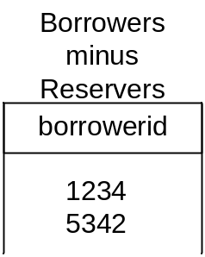
SET DIFFERENCE Exercise:
Find the borrower numbers of all borrowers who have borrowed something and reserved nothing.
Reservers = project Reserves over borrowerid
Borrowers = project Borrows over borrowerid
Answer = Borrowers minus Reservers
alternatively
Reservers = π_{borrowerid} (Reserves)
Borrowers = π_{borrowerid}(Borrows)
Answer = Borrowers - Reservers
Database Principles

